Slide 1
Spark on AWS
Using EMR, S3, and EC2
Created by Tucker Lewis

Slide 2
Acknowledgment
Material provided by Tucker Lewis, MSiA alumni
All credits go to Tucker

Slide 3
Agenda
What are the tools?
S3
EMR and EC2
Spark Job
Creating your resources
Uploading files
Executing your job
Logging and Debug

Slide 4
What Are The Tools?

Slide 5
What is S3?
Amazon S3 (Simple Storage Service) is the primary cloud-based storage service offered by AWS
S3 allows users to store and retrieve data from anywhere on the internet, with durability, availability, scalability, and security
Users can cheaply store any amount of data in S3, with no limit on the number of objects or the size of each object.
S3 provides various storage classes to optimize cost and performance for different use cases and usage patterns
We will use S3 to store our data, python file, logs, and outputs
Some information adapted from chatGPT prompts

Slide 6
What is EMR?
Amazon EMR (Elastic MapReduce) is a cloud-based big data processing service offered by Amazon Web Services (AWS)
EMR enables users to quickly and easily provision, configure, and scale a Hadoop or Spark cluster in the cloud, without having to manage the underlying infrastructure
EMR provides a range of big data processing and analysis tools, including Spark, and Presto, as well as custom applications
We will use EMR to launch a Spark cluster and orchestrate our Spark jobs
Some information adapted from chatGPT prompts

Slide 7
What is EC2?
Amazon EC2 (Elastic Compute Cloud) is a cloud-based service offered by Amazon Web Services (AWS) that provides resizable compute capacity in the cloud
EC2 instances can be launched on-demand and scaled up or down based on workload demands
EC2 instances are available in a range of configurations, from general-purpose to memory-optimized and compute-optimized instances
EC2 instances are commonly used to run applications and workloads, such as web applications, big data processing, and machine learning
For this tutorial, it is important to know that to execute an EMR job, EMR is going to launch EC2 instances
Spark clusters require a primary node, a core node, and multiple task nodes to execute. All of these are from EC2!
Some information adapted from chatGPT prompts

Slide 8
Spark
Apache Spark is a distributed computing system that provides a unified framework for processing large-scale data processing in a parallel and fault-tolerant manner
In Data Engineering, Spark is often used to process large volumes of data, transform it into a structured format, and prepare it for downstream analysis
Data engineers can use Spark to perform various data transformation tasks, such as filtering, aggregating, joining, and pivoting data, using
Spark utilizes high-level API wrappers for its code, allowing users to write Spark in Scala, Python (PySpark), and Java, with additional wrappers for SQL and a pandas-style API called Koalas
Some information adapted from chatGPT prompts

Slide 9
EMR, EC2 and Spark
In the context of Spark execution, EC2 instances can be used as compute nodes to run Spark tasks and data processing jobs
This execution is orchestrated by the EMR cluster
EC2 instances can be configured to work with different storage options, such as Amazon S3 to store and process data used by Spark jobs
EC2 instances can be launched as part of a Spark cluster, where each instance runs a Spark executor to process tasks in parallel

Slide 10
What Does an EC2 Spark Job Look Like?
Create your S3 ’bucket’
In this example, it will hold both your inputs, outputs, and code, as well as any optional config files
Create an EMR cluster
This will serve as the compute for your Spark job, but will also serve as the interface for executing the job
Add a ’Step’ to your EMR cluster
This is your spark
EMR logs
You may need to review the logs in case of failures
Spark UI
While we do not extensively cover the Spark UI in this tutorial, there is a lot of information from more complex jobs that can be found in the UI and used for performance tuning and diagnosing code problems

Slide 11
Creating Your Resources

Slide 12
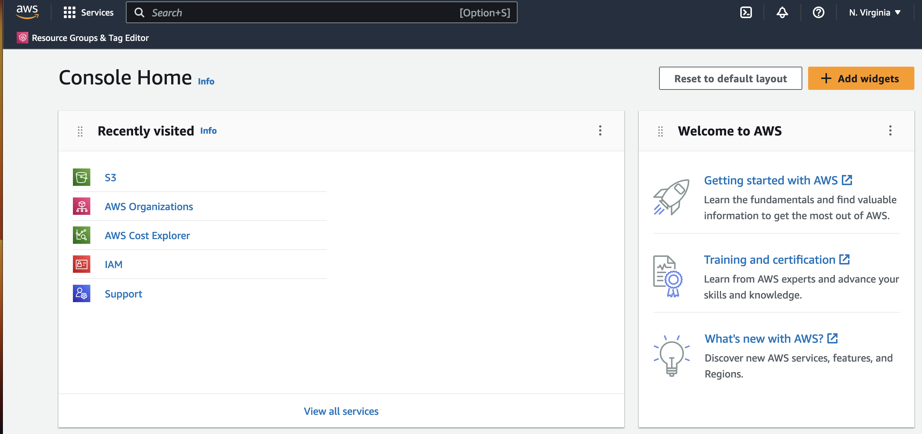
AWS Management Console
Sign in to your AWS Account
The AWS Management Console is a hub for resource health, application status, cost information, and much more
In the top search bar:
Search ’S3’ and open S3 in a new tab
Search ‘EC2’ and open EC2 in a new tab

Slide 13
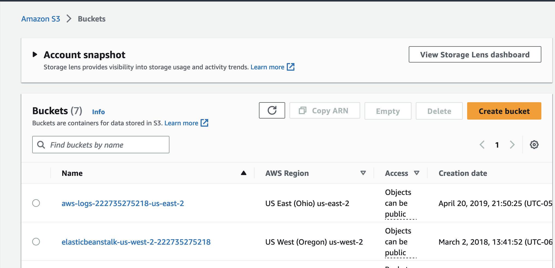
S3
On the S3 home page, select ’Create a Bucket’

Slide 14
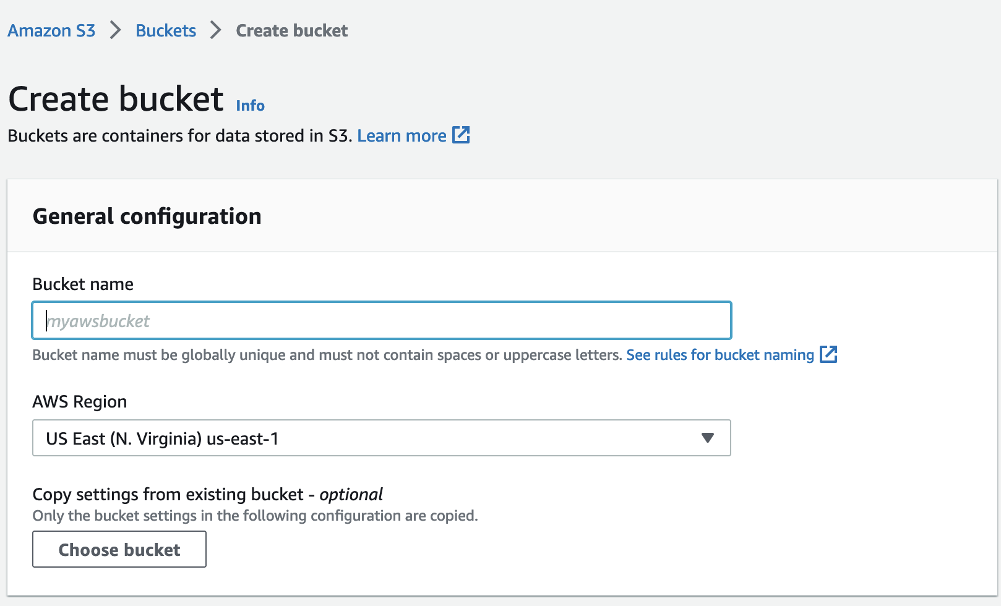
S3
Name your bucket
For the purpose of this tutorial, you do not need to change any options
All interfacing with the bucket will happen with your account, or resources associated with it
Scroll down to the bottom and create your bucket!

Slide 15
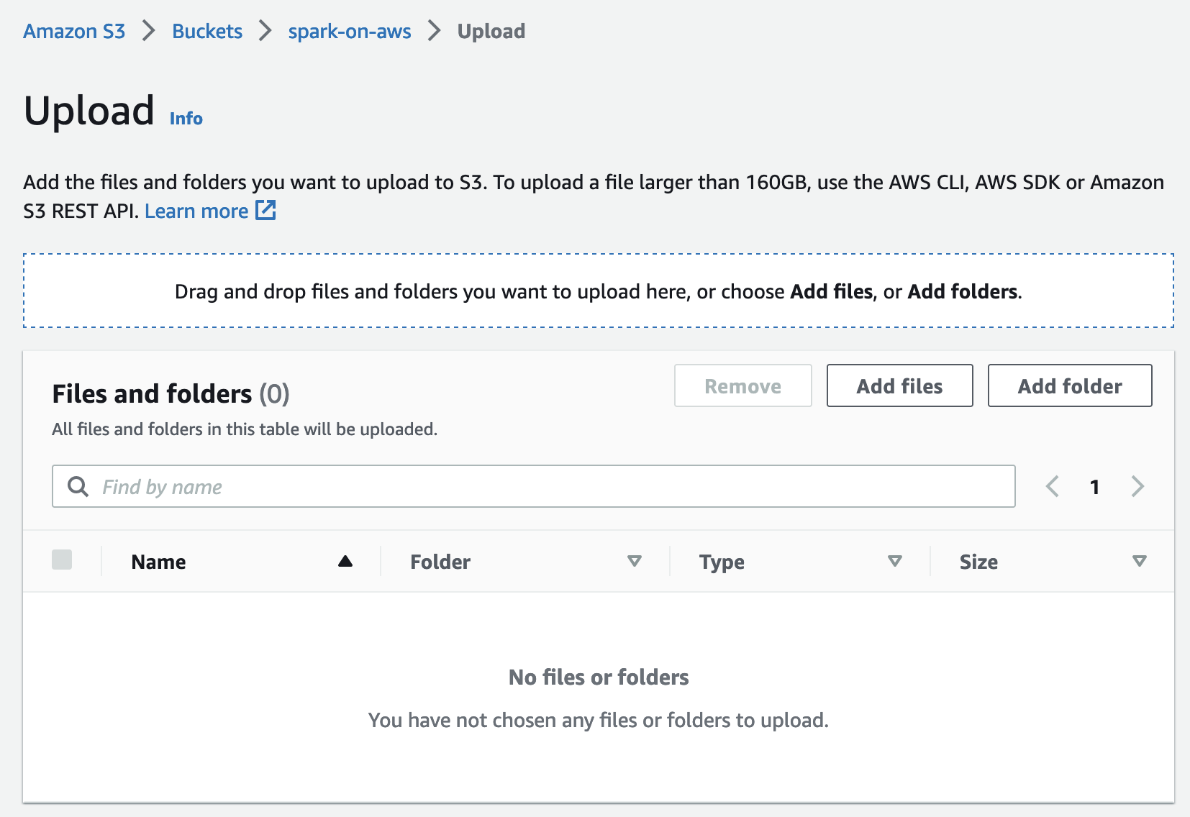
S3: Upload Files
We are going to upload 3 files:
sampling.py
Our python script
Make sure to edit the S3 paths in this python script to the name of your S3 bucket!
sample.csv
Data we will be sampling
Can be any csv
bootstrap_pandas.sh
This is a script we will load onto our EC2 nodes in EMR so that we can use pandas in our python script
You can use this format to load other libraries, or ignore if it is not needed

Slide 16
EMR: Preface
Once you terminate an EMR cluster, it cannot be recovered, though the EC2 logs will be accessible for a time
However, you can clone the EMR cluster without needing to manage each individual option again
You an also rerun

Slide 17
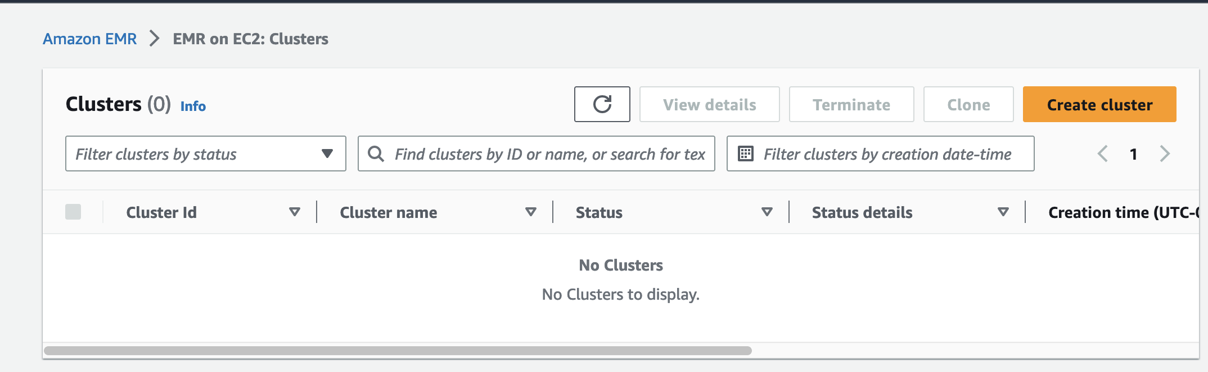
EMR
This EMR tab will show different clusters you have created
Each cluster will have its own tab for jobs executed on the cluster
BE SURE TO TERMINATE CLUSTERS WHEN THEY ARE NOT IN USE
Clusters with inexpensive EC2 will be inexpensive until they are running for an extended period of time

Slide 18
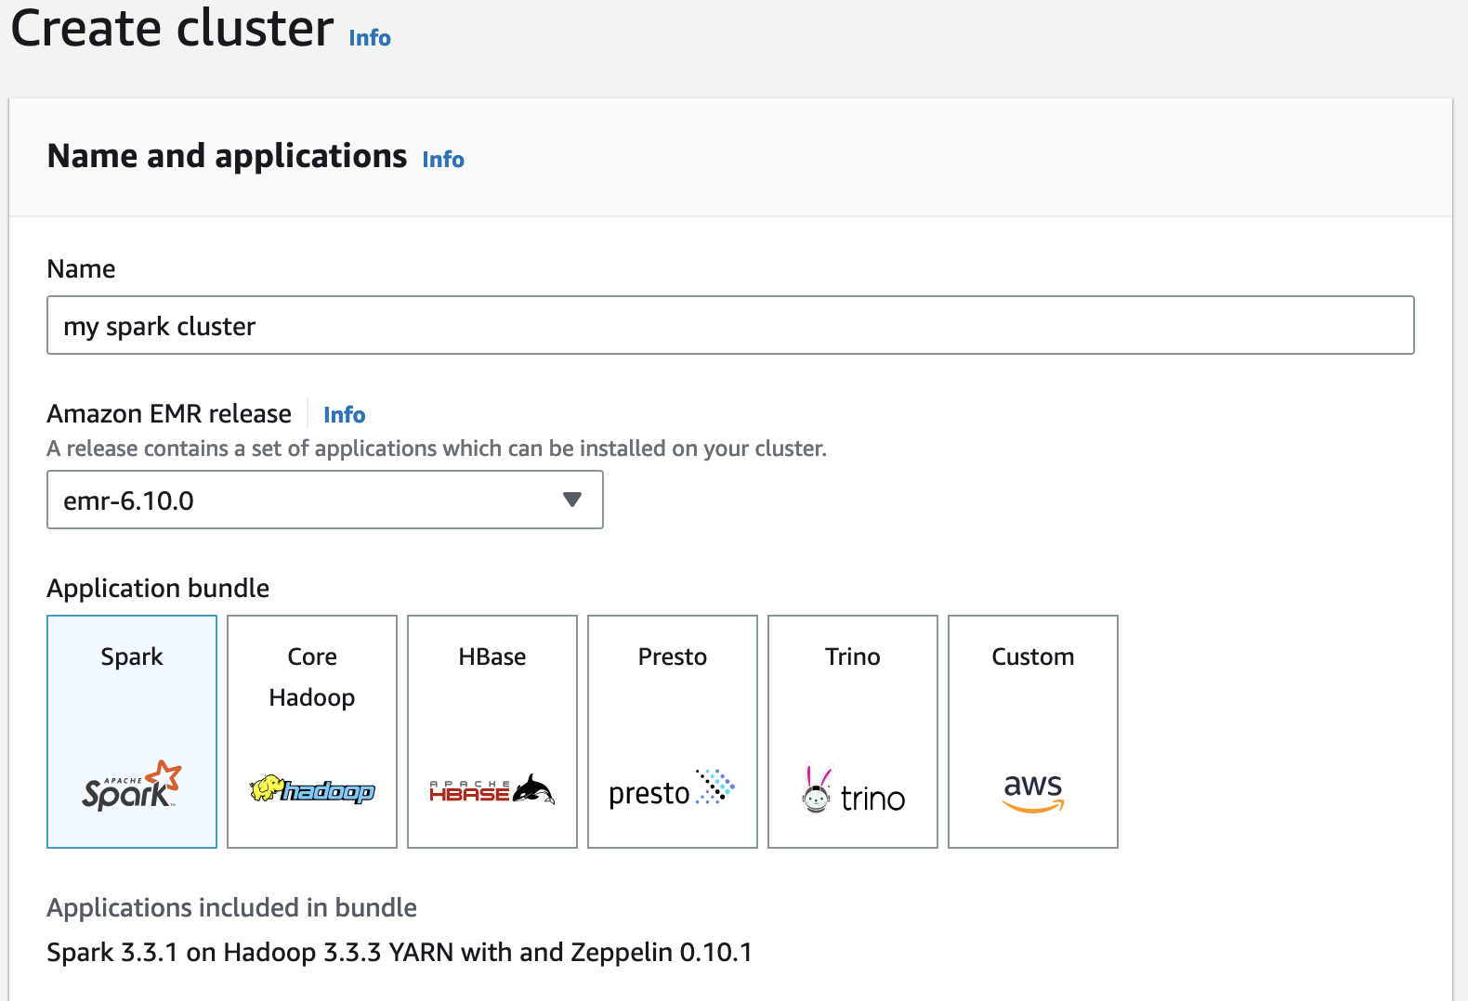
EMR
Select ‘Create a Cluster’ on the EMR hub
Use emr-6.10.0
This will come with Spark 3.3.1

Slide 19
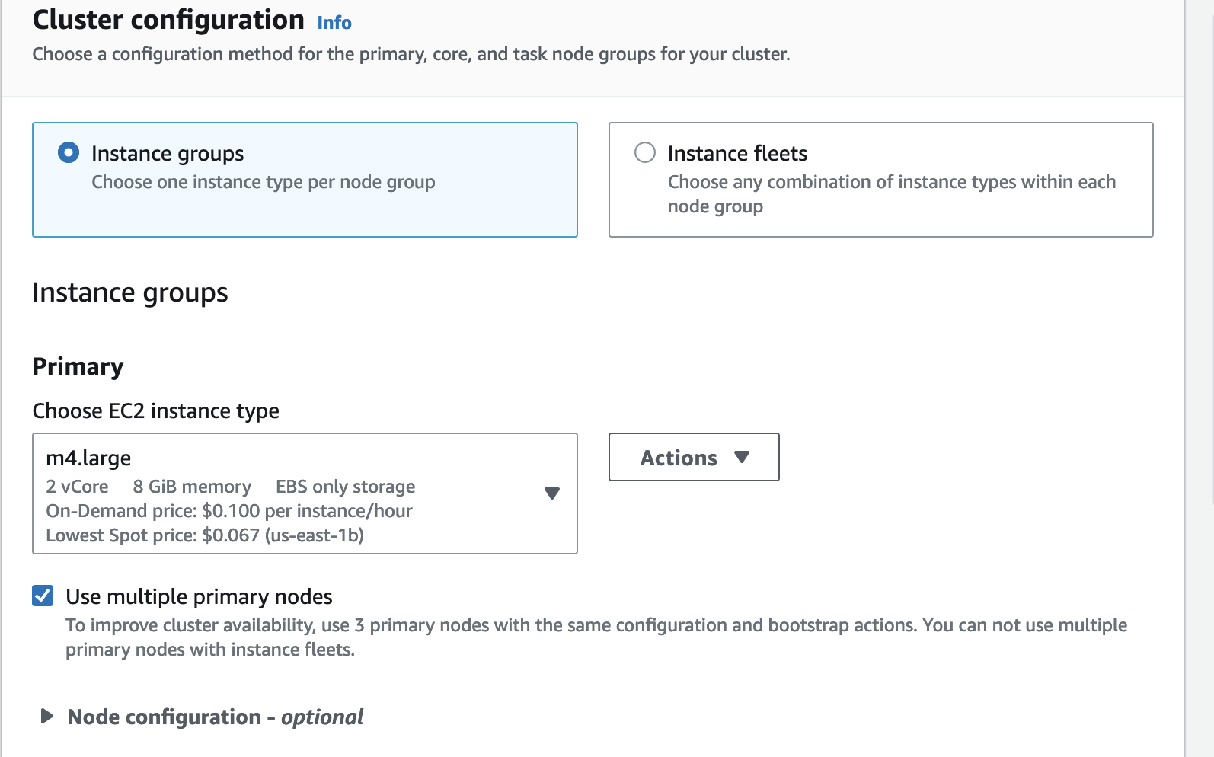
EMR
Change your instance primary to m4.large
This is a cheaper EC2 instance which still has plenty of power for most applications
If there are significant performance issues not caused by user error or poor optimization, you can consider changing this

Slide 20
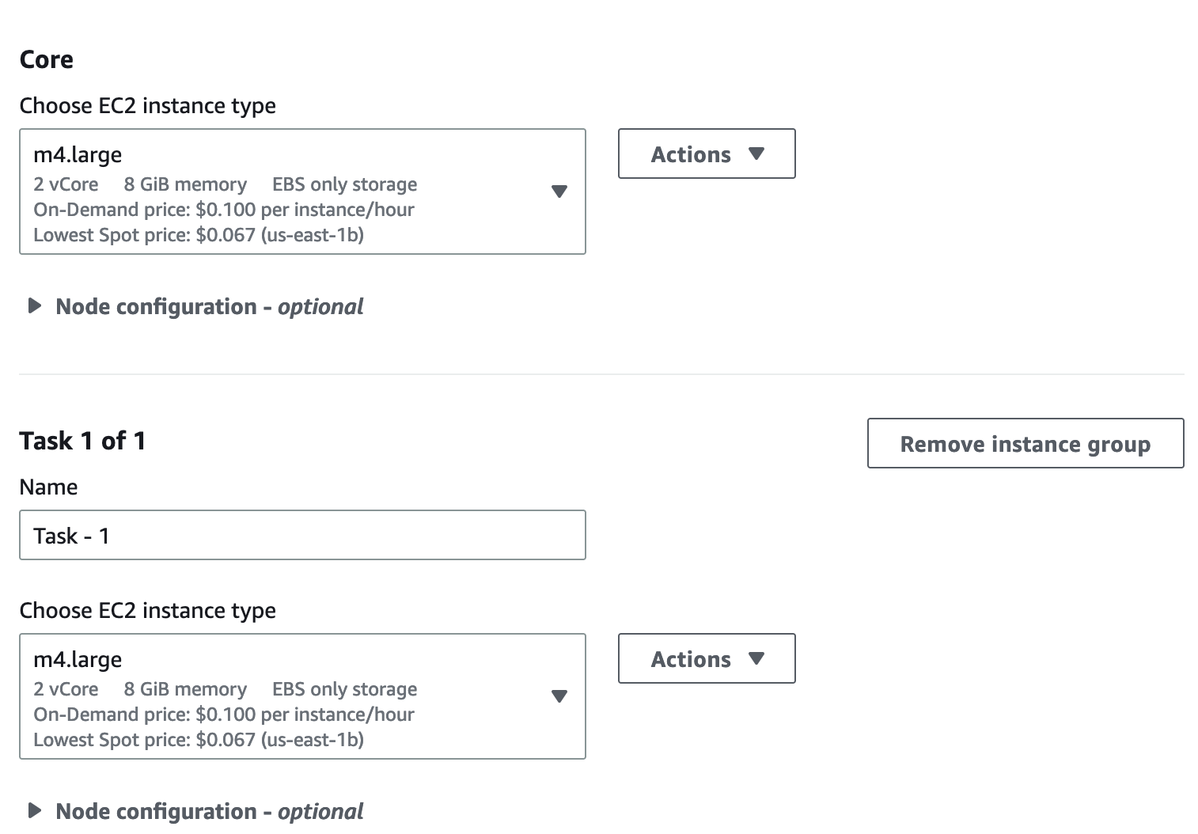
EMR
Change the core compute to m4.large as well
Change the task compute to m4.large

Slide 21
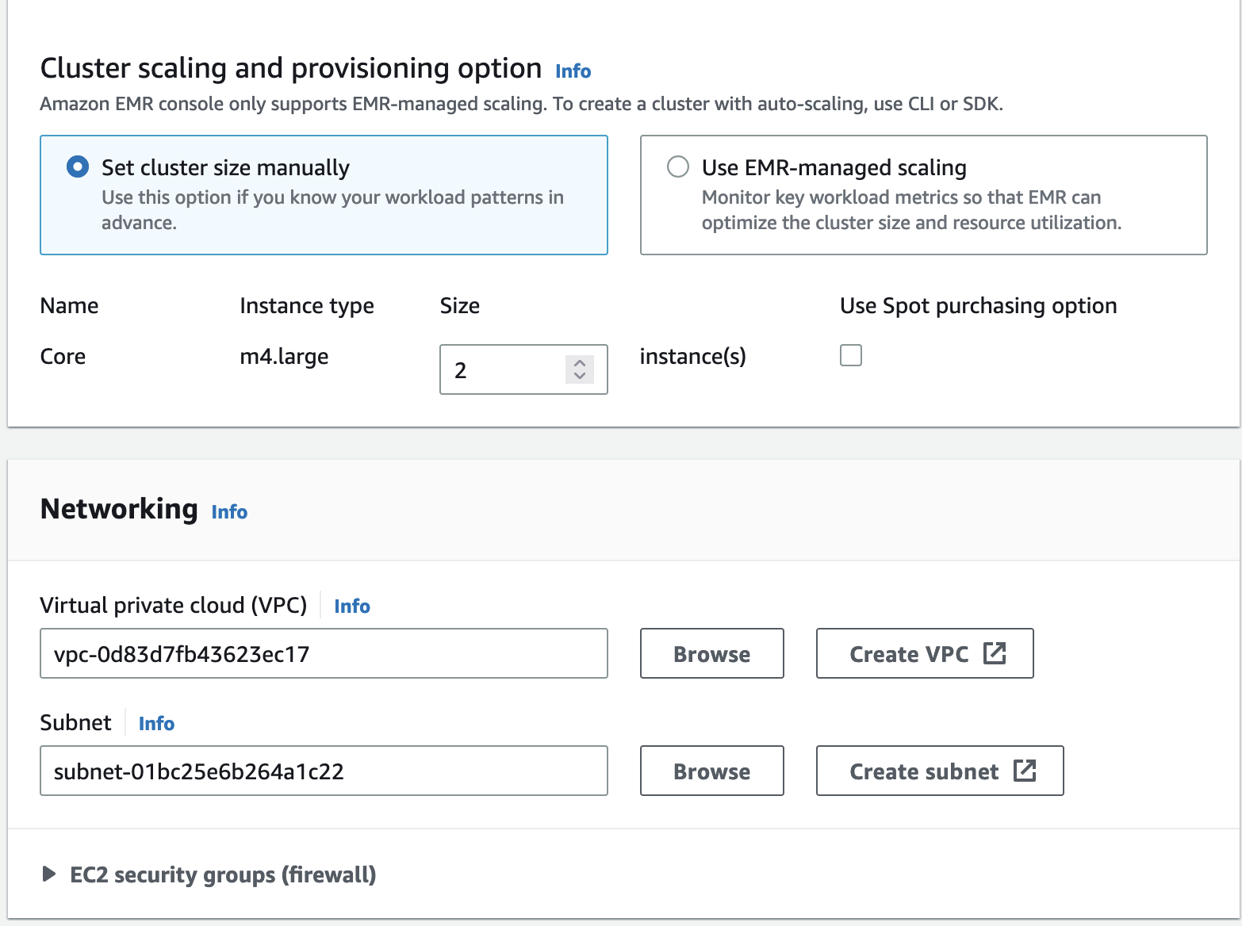
EMR
Assign 1 core node
Assign 2 task nodes
Reference on what these are:
https://docs.aws.amazon.com/emr/latest/ManagementGuide/emr-master-core-task-nodes.html

Slide 22
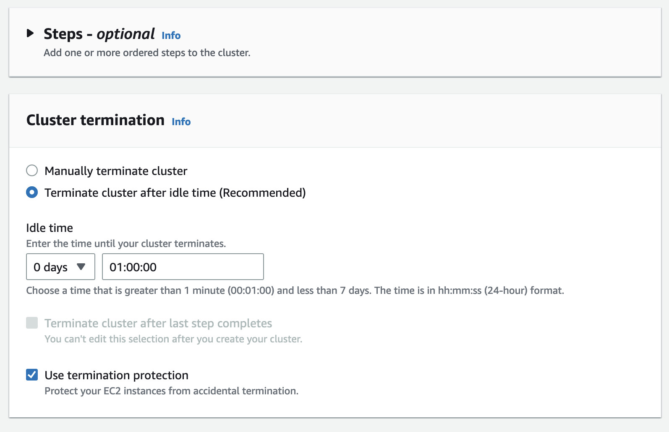
EMR
Steps:
We will add a step later!
If we add a step now, it will execute any time we start the cluster, which can be handy, but we will skip for now
Cluster Termination:
The default is to auto-terminate after an hour
Even if you do want to extend the auto-terminate window, I HIGHLY recommend to keep idle termination enabled

Slide 23
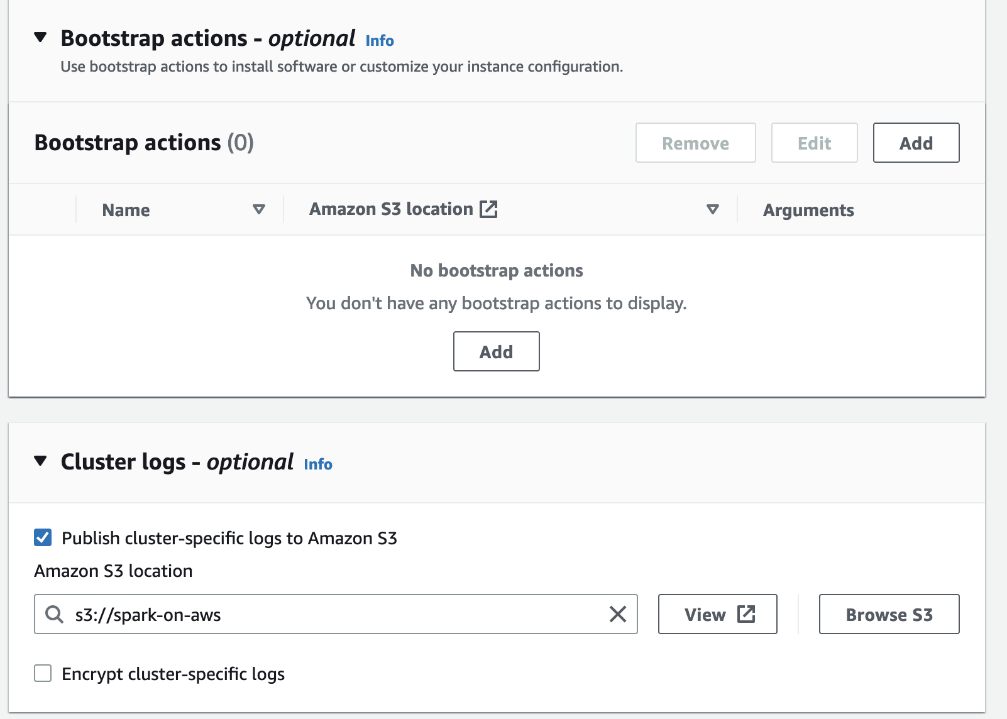
EMR
Bootstrap action
Here we will add the S3 path to our pandas_bootstrap script
Cluster logs
You can specify an S3 bucket to store our logs on, I will use the same one here
A directory will be made in this S3 bucket with the unique cluster ID
I would recommend creating an directory for EMR logs:
S3://spark-on-aws/logs/
If you make multiple clusters, the logs will crowd up your base S3 quickly

Slide 24
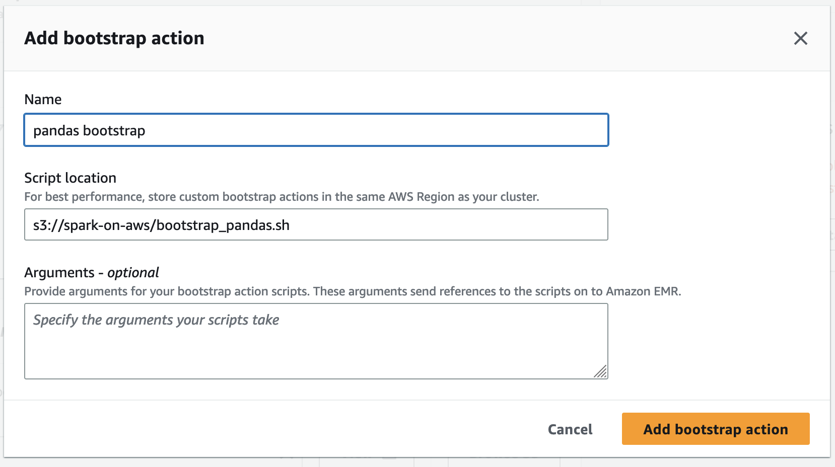
EMR
Name your bootstrap
Copy the S3 URI for the bootstrap
Paste it into the script location

Slide 25
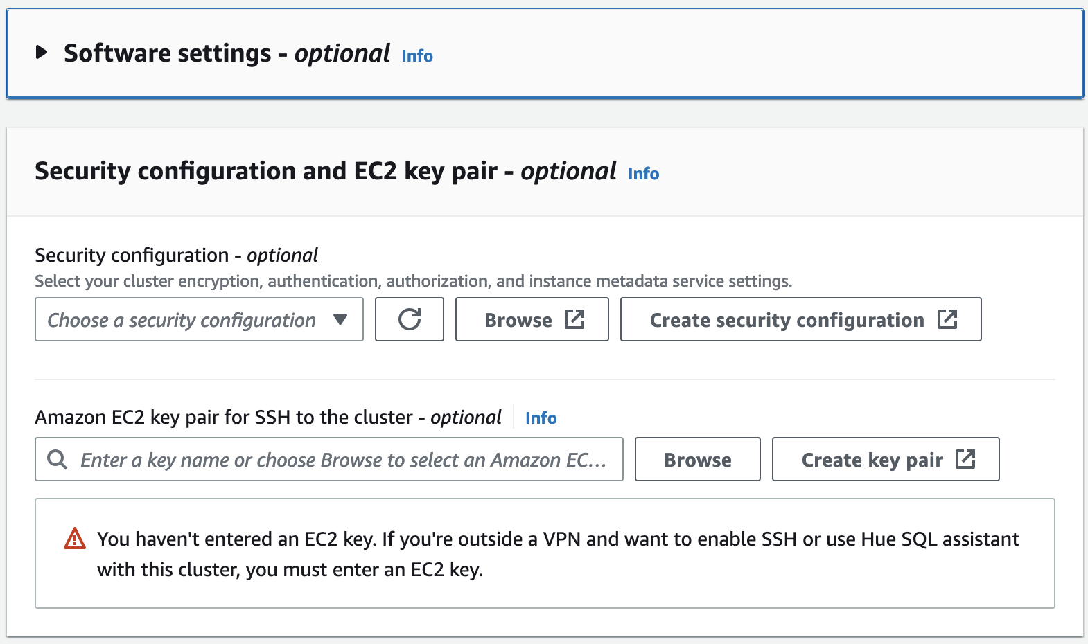
EMR
Nothing in Software settings
We will not be configuring an SSH key-pair
If you want to explore the EMR cluster name node using an SSH shell, you will need to:
Create an EC2 Key Pair
Add the keypair here
Configure your key with an SSH tool like PuTTY

Slide 26
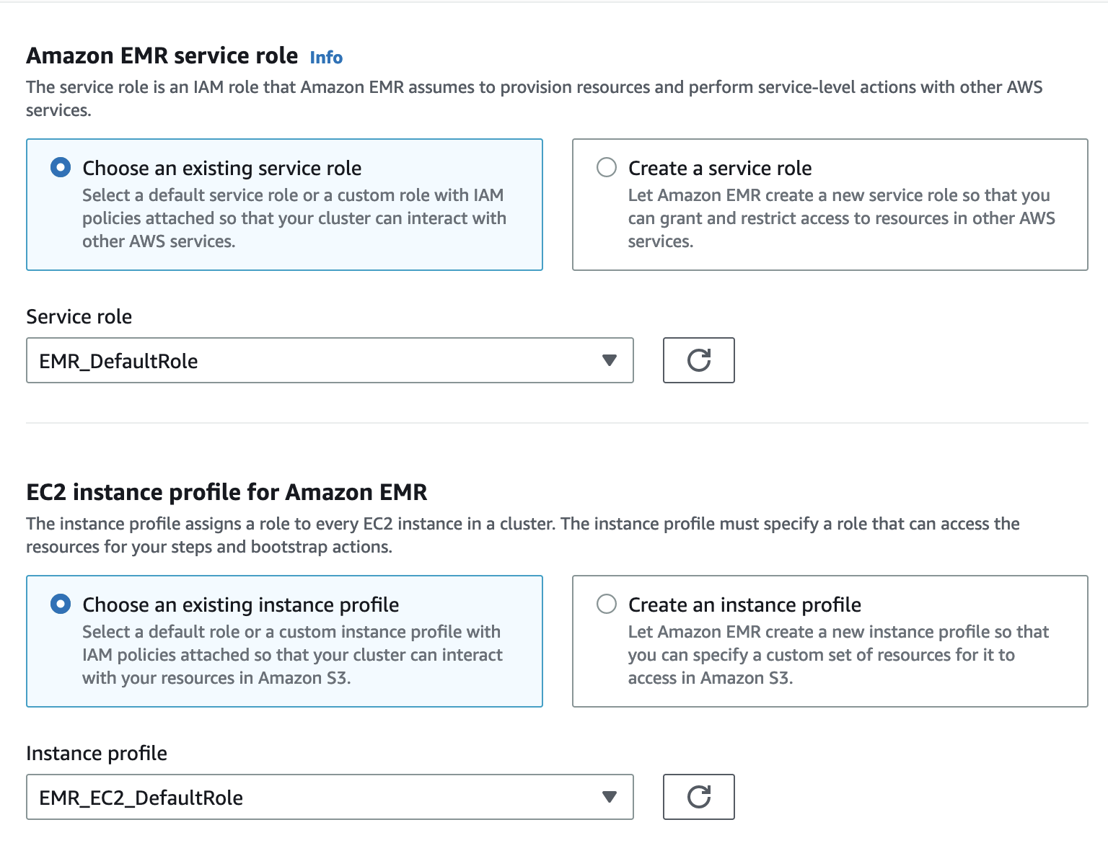
Security
EMR and EC2 defaults
IAM services on AWS are not needed for this particular tutorial

Slide 27
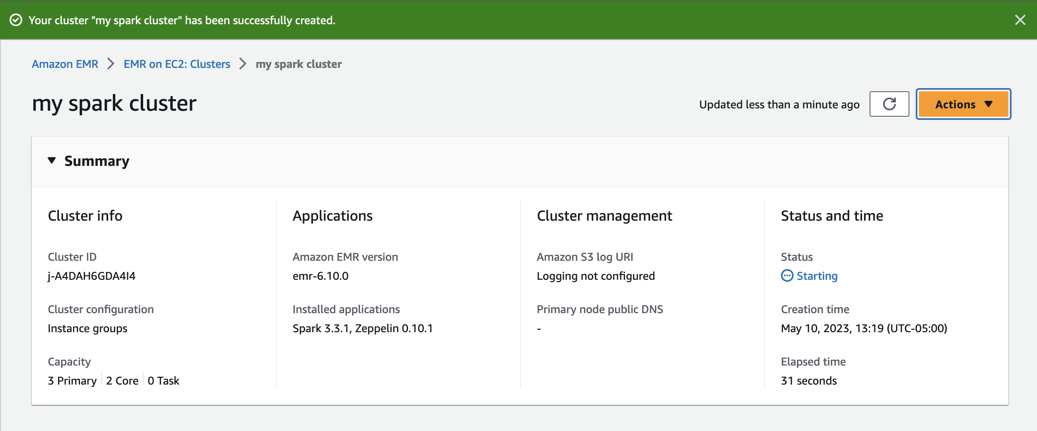
EMR
Create the cluster!

Slide 28
Running your Spark Job

Slide 29
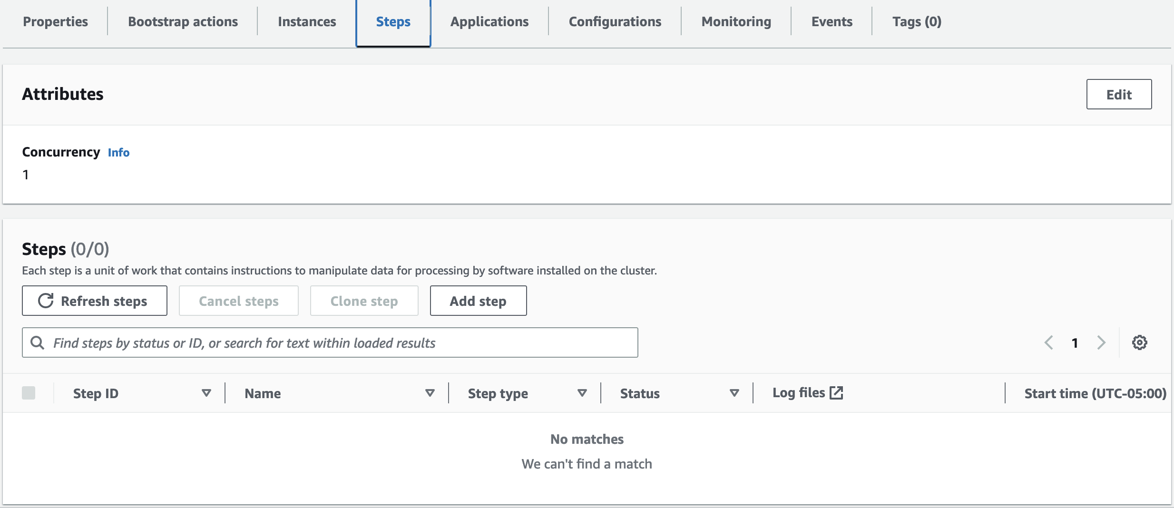
EMR: Spark
We are now going to configure a ‘Step’
This is how we will execute our Spark job
These can also be created as part of the EMR cluster
This can be helpful for automated job scheduling
For this tutorial, we want to keep the cluster up in case we want to run the job multiple times, for debugging etc.

Slide 30
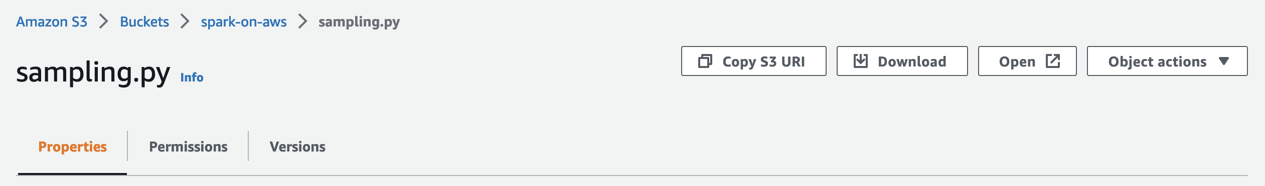
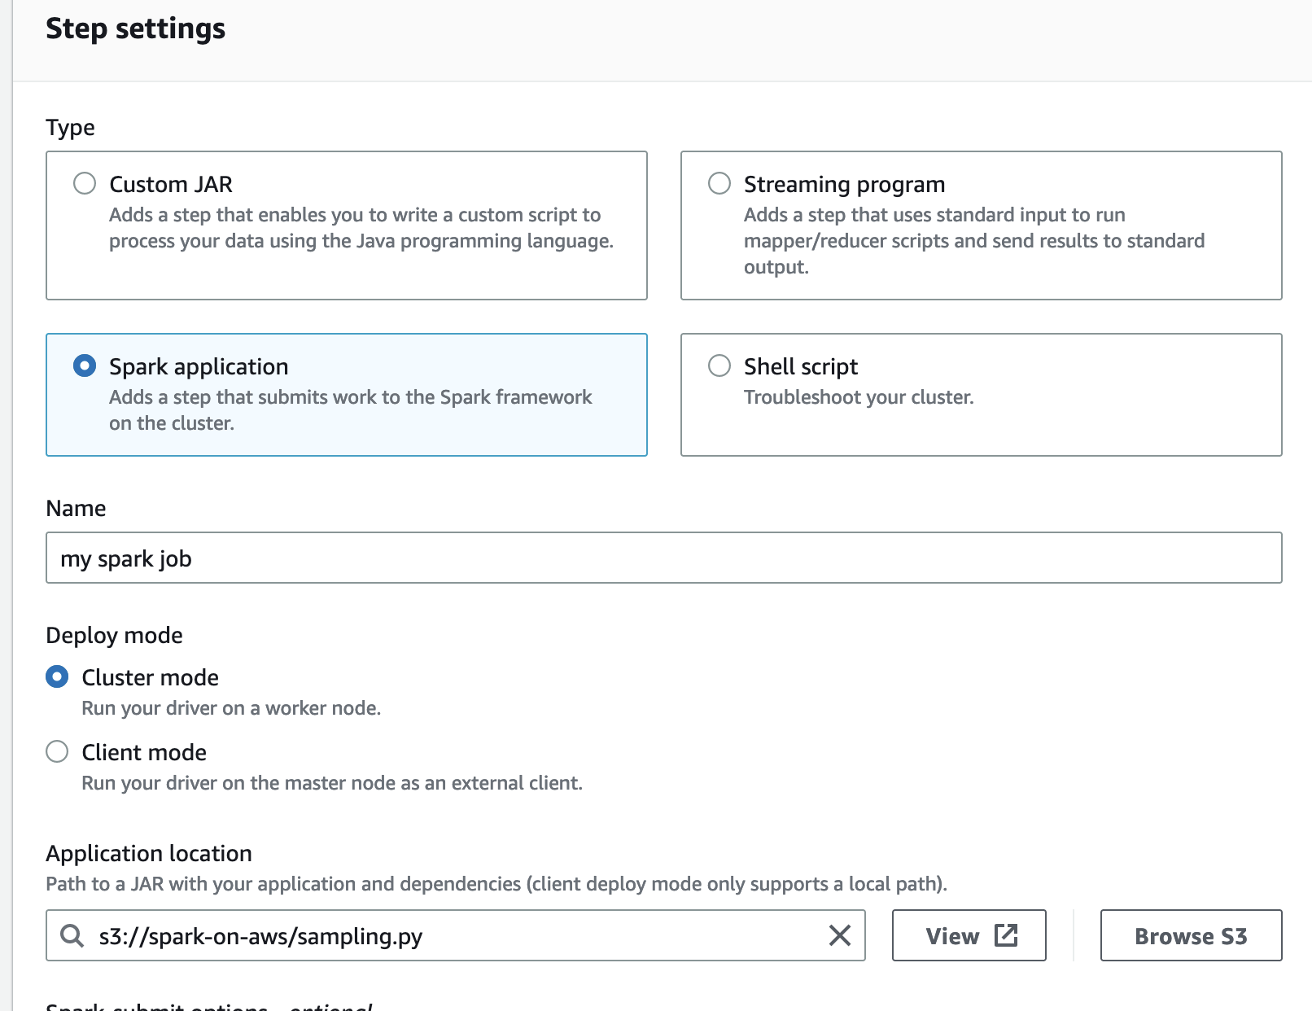
EMR: Spark
Click on ‘sampling.py’ in your S3 bucket and copy the S3 UR
In your EMR step, select ’Spark Application’
Name your step
Paste URI into ‘Application Location’
You can also ‘Browse S3’ to select the file location

Slide 31
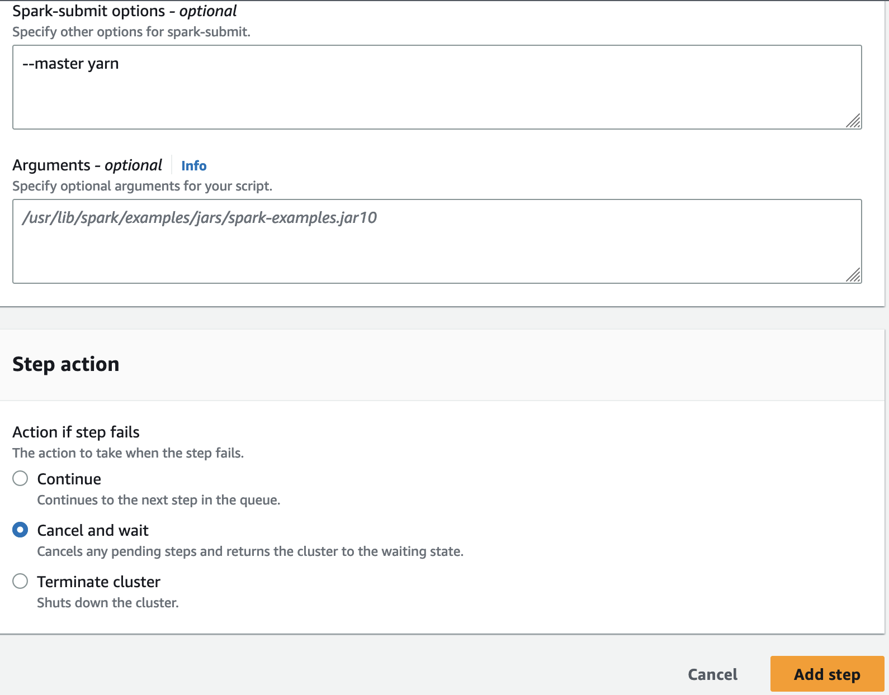
EMR: Spark
Add a spark-submit option
‘--master yarn’
Specifies yarn as the resource manager
Empty arguments
Step action: Cancel and wait
If your job fails, you likely want to explore the stdout and stderr logs, so you don’t want to terminate
The cluster has an auto-terminate after an hour anyway

Slide 32
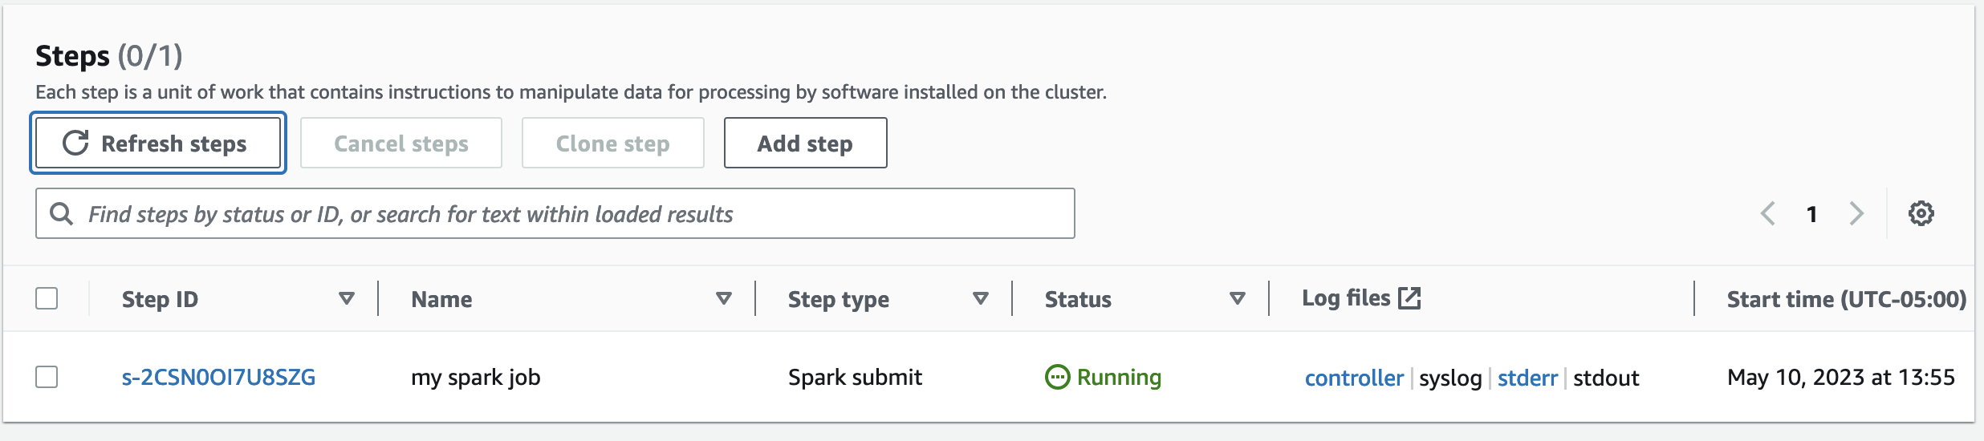
Check out that job!

Slide 33
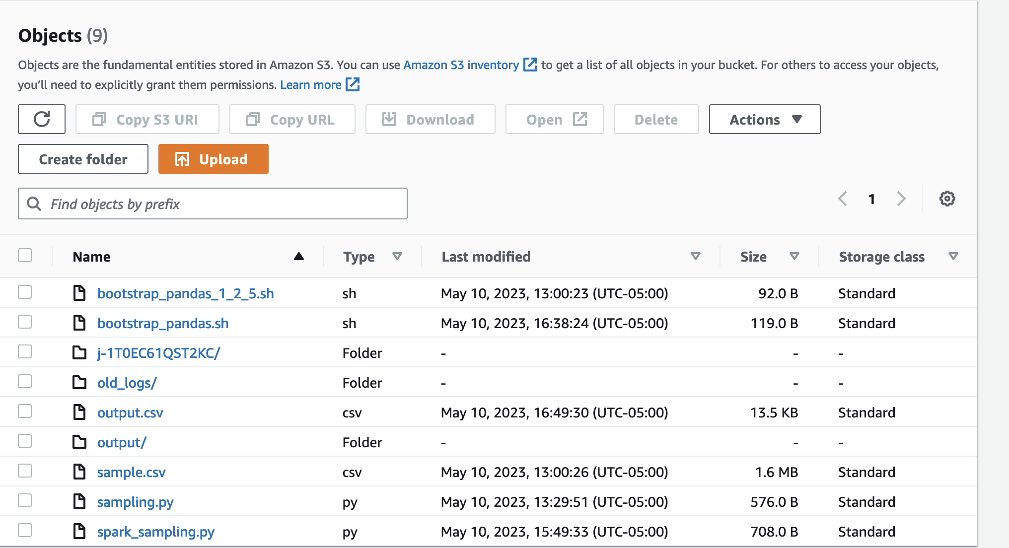
Job Complete!
Let’s check on our outputs in the s3 bucket
We’re expecting a spark-formed csv in the output/ directory and an output.csv written by pandas

Slide 34
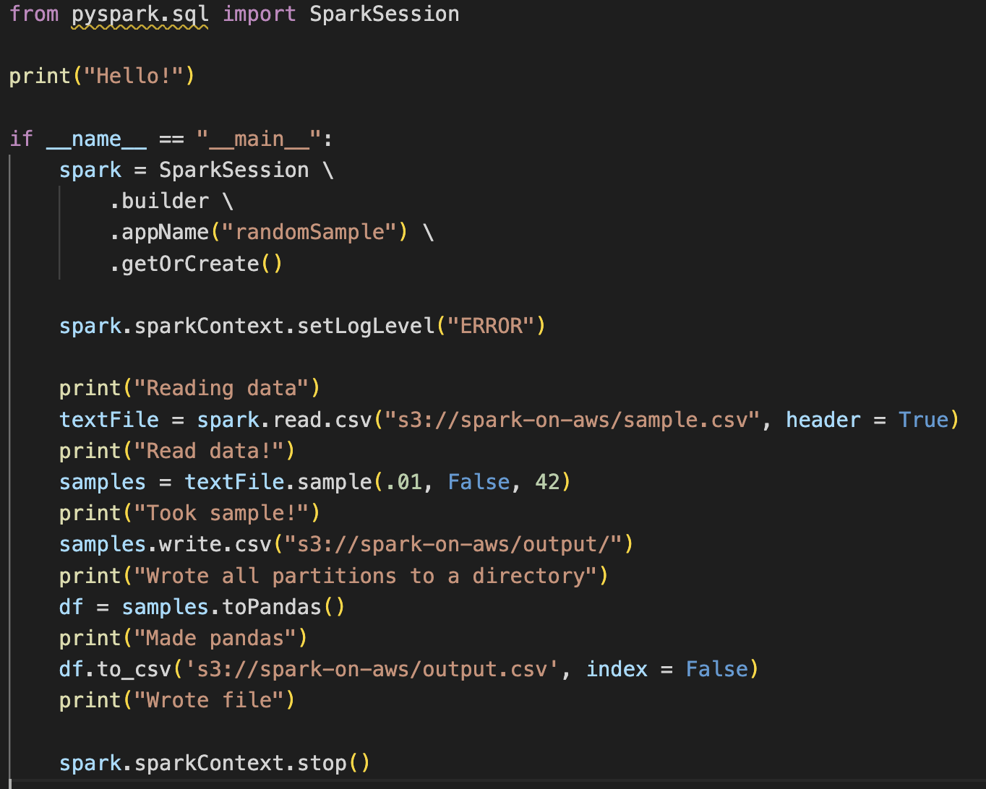
A few notes on the Python script
This is the code in sampling.py
We create a spark session with an app name
We set the application log level to ‘ERROR’
This will reduce the noise from INFO logs
You’ll notice that each step has a print statement
This is helpful to identify where an application might be hanging
There is no need to use pandas, except:
To orchestrate what bootstrap files are and how they work
Spark would write csv’s in multiple partitions to a directory, which might not be useful if we are taking a smaller sample of a dataset

Slide 35
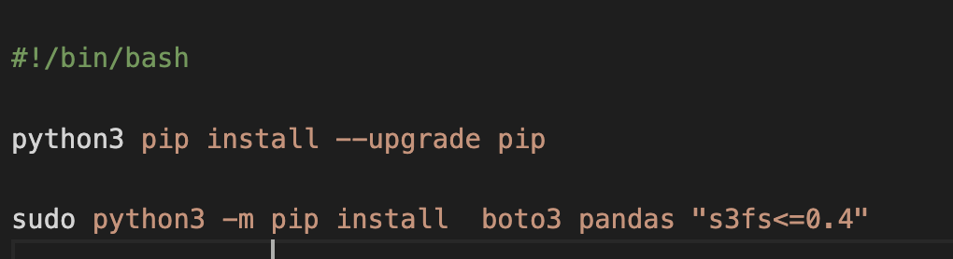
What’s in the Bootstrap.sh?
In order for pandas to write between EMR and S3, we need to have a python package called s3fs
You’re right that if we weren’t using the pandas option, we wouldn’t need the bootstrap!
It is common in cloud computing to have multiple libraries with potentially conflicting versions
All the more reason for:
virtual environments
requirements.txt
Containerization
Docker

Slide 36
Output Logs and Debugging

Slide 37
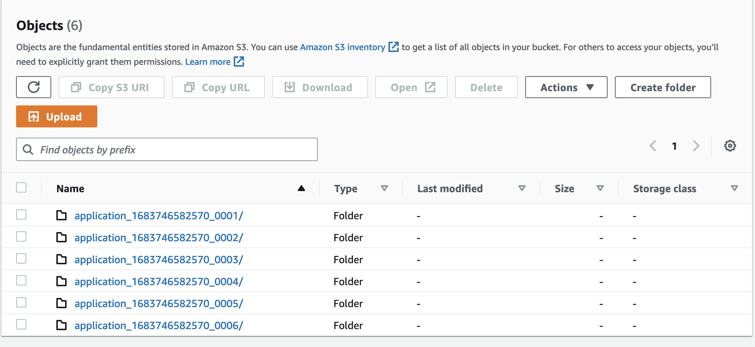
A few notes on stderr and stdout
The stderr we see on the ‘Steps’ page will only contain the stderr of the Spark job
So any non-Spark errors will be missing, and so will the stdout print messages
This is because we chose a cluster deploy mode
These logs are still accessible in the ’containers’ tab under the cluster log:
Each step will get its own subdirectory in the order of execution:
These logs do take some time to populate and will not be available instantly

Slide 38
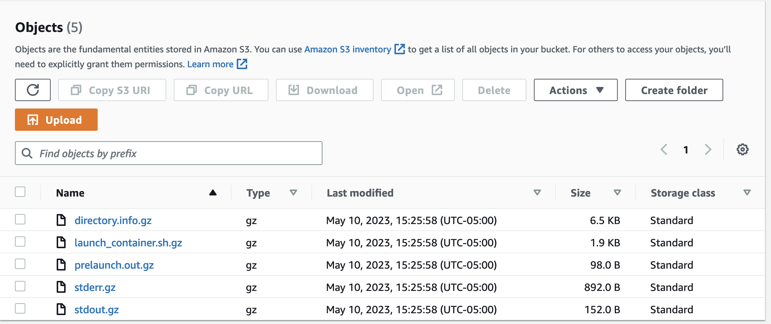
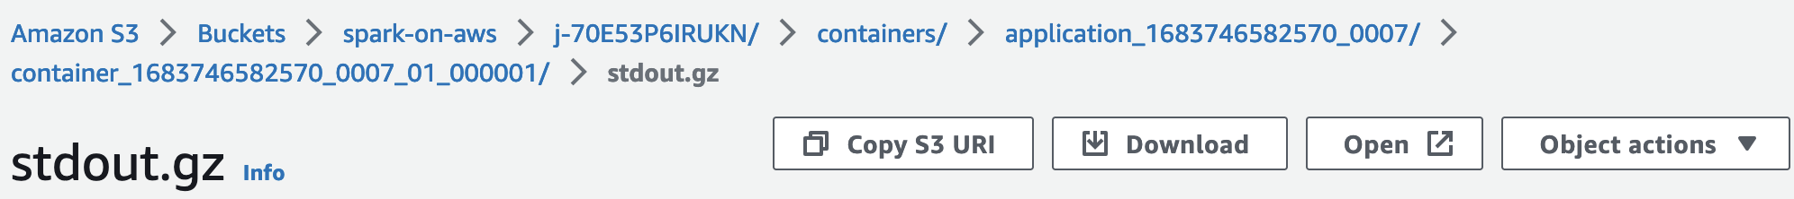
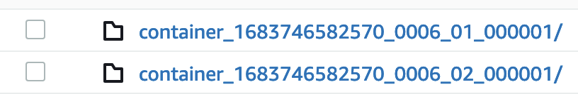
A few notes on stderr and stdout
There will be multiple directories for each job. These correspond to each of the compute nodes
One will contain the master stdout, which is the most important to us
The others will contain the task node stdout from Spark executors
The one ending in 01_000001/ is typically the main node

Slide 39
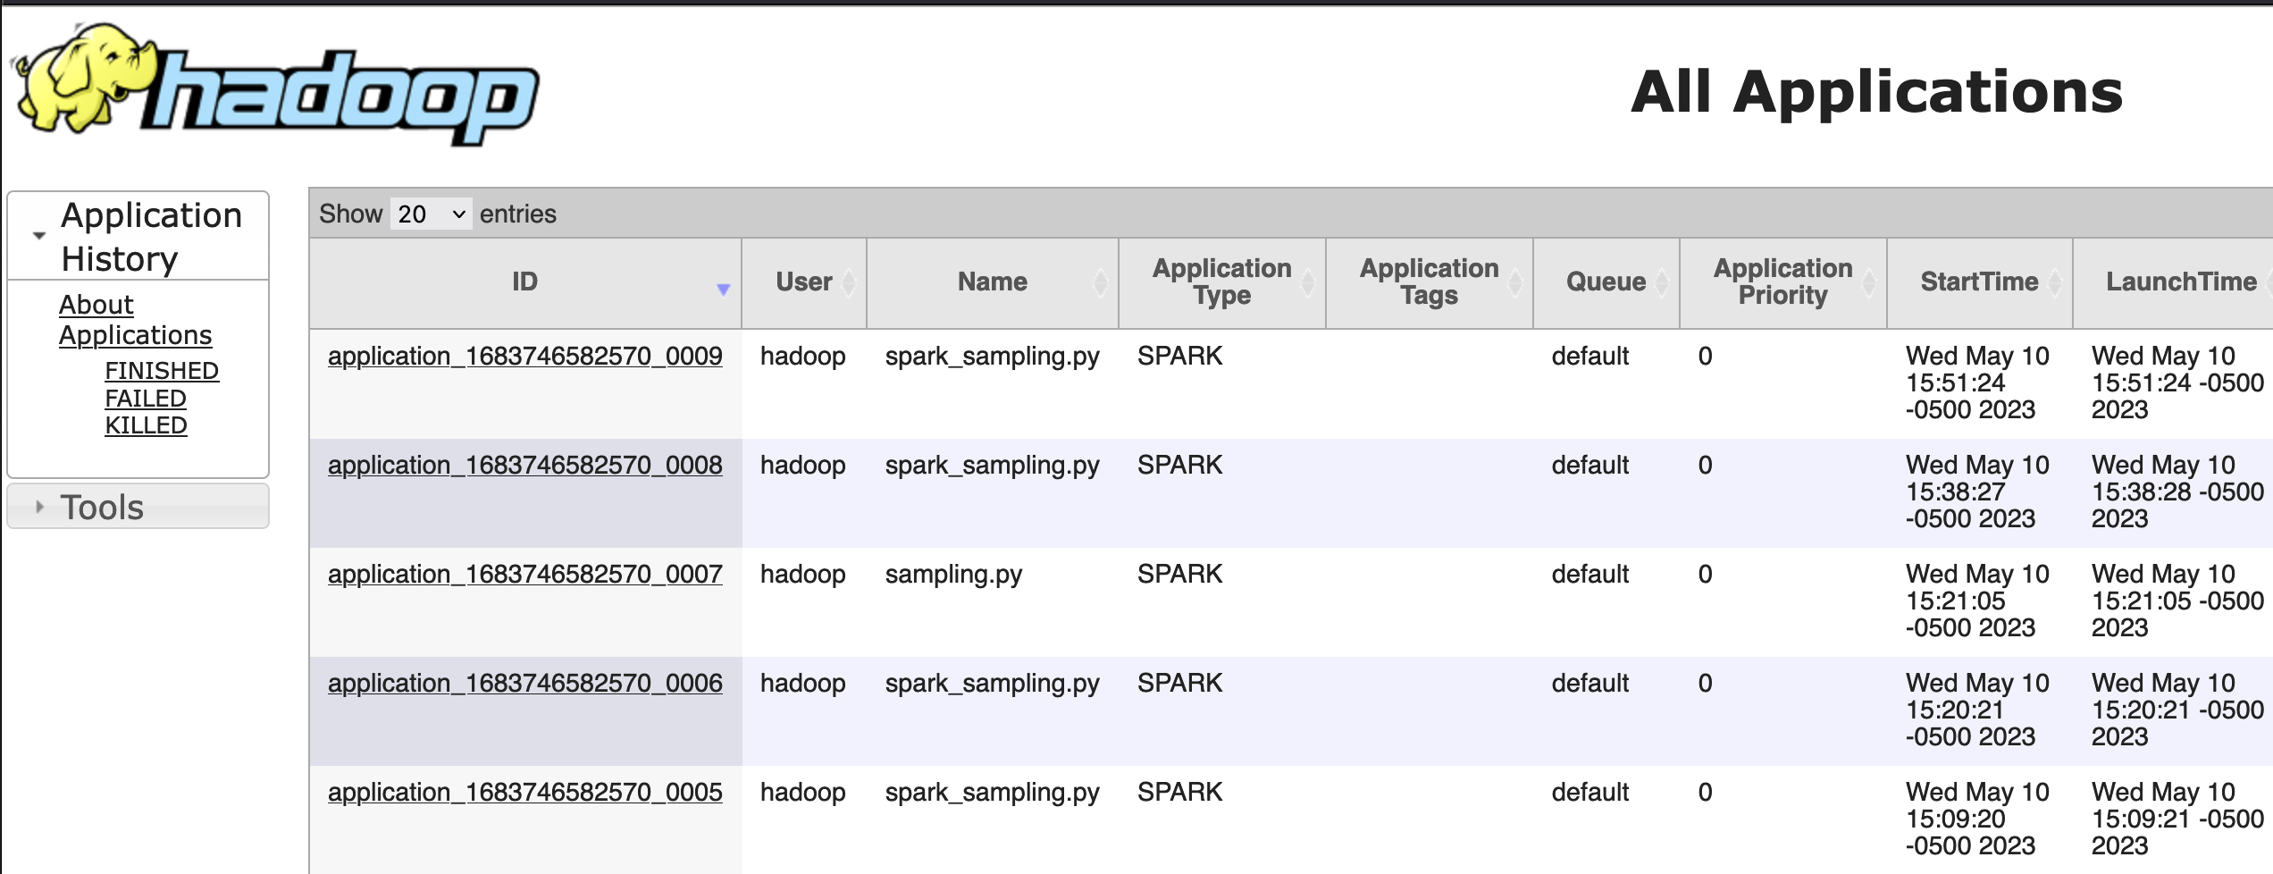
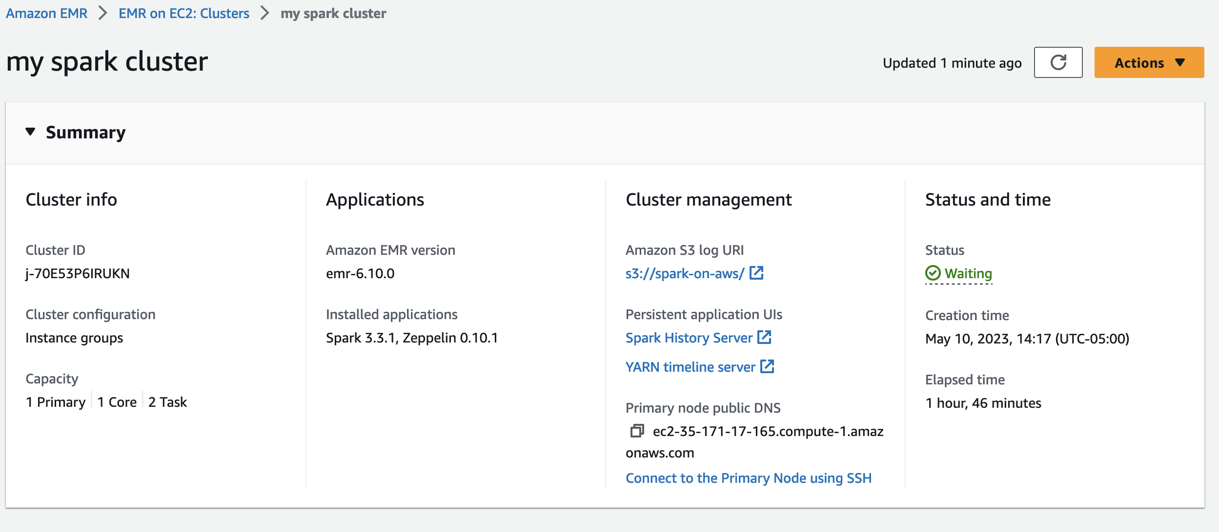
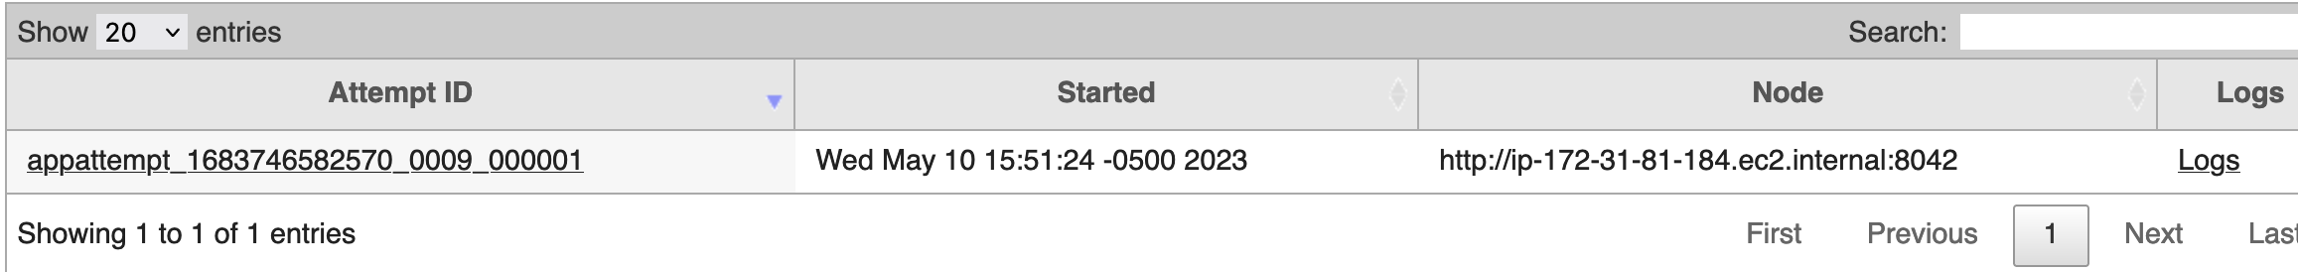
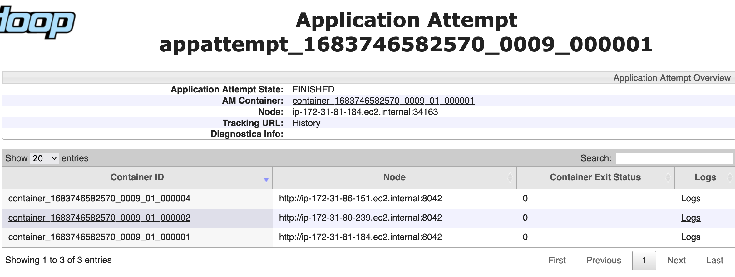
A few notes on stderr and stdout
You can also access these application logs in the Hadoop YARN timeline server

Slide 40
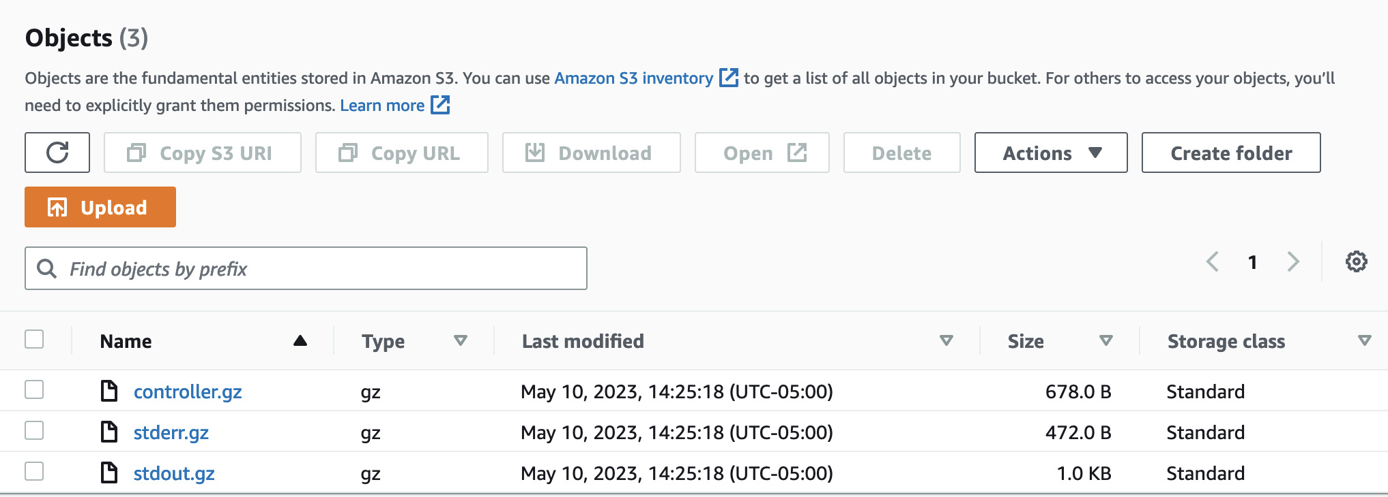
Bootstrap stderr and stdout
When loading custom packages to EMR, you may encounter difficult issues, or package dependency problems that might not cause an error
You can locate the bootstrap logs in the node logs:
* All nodes will have the same bootstrap action

Slide 41
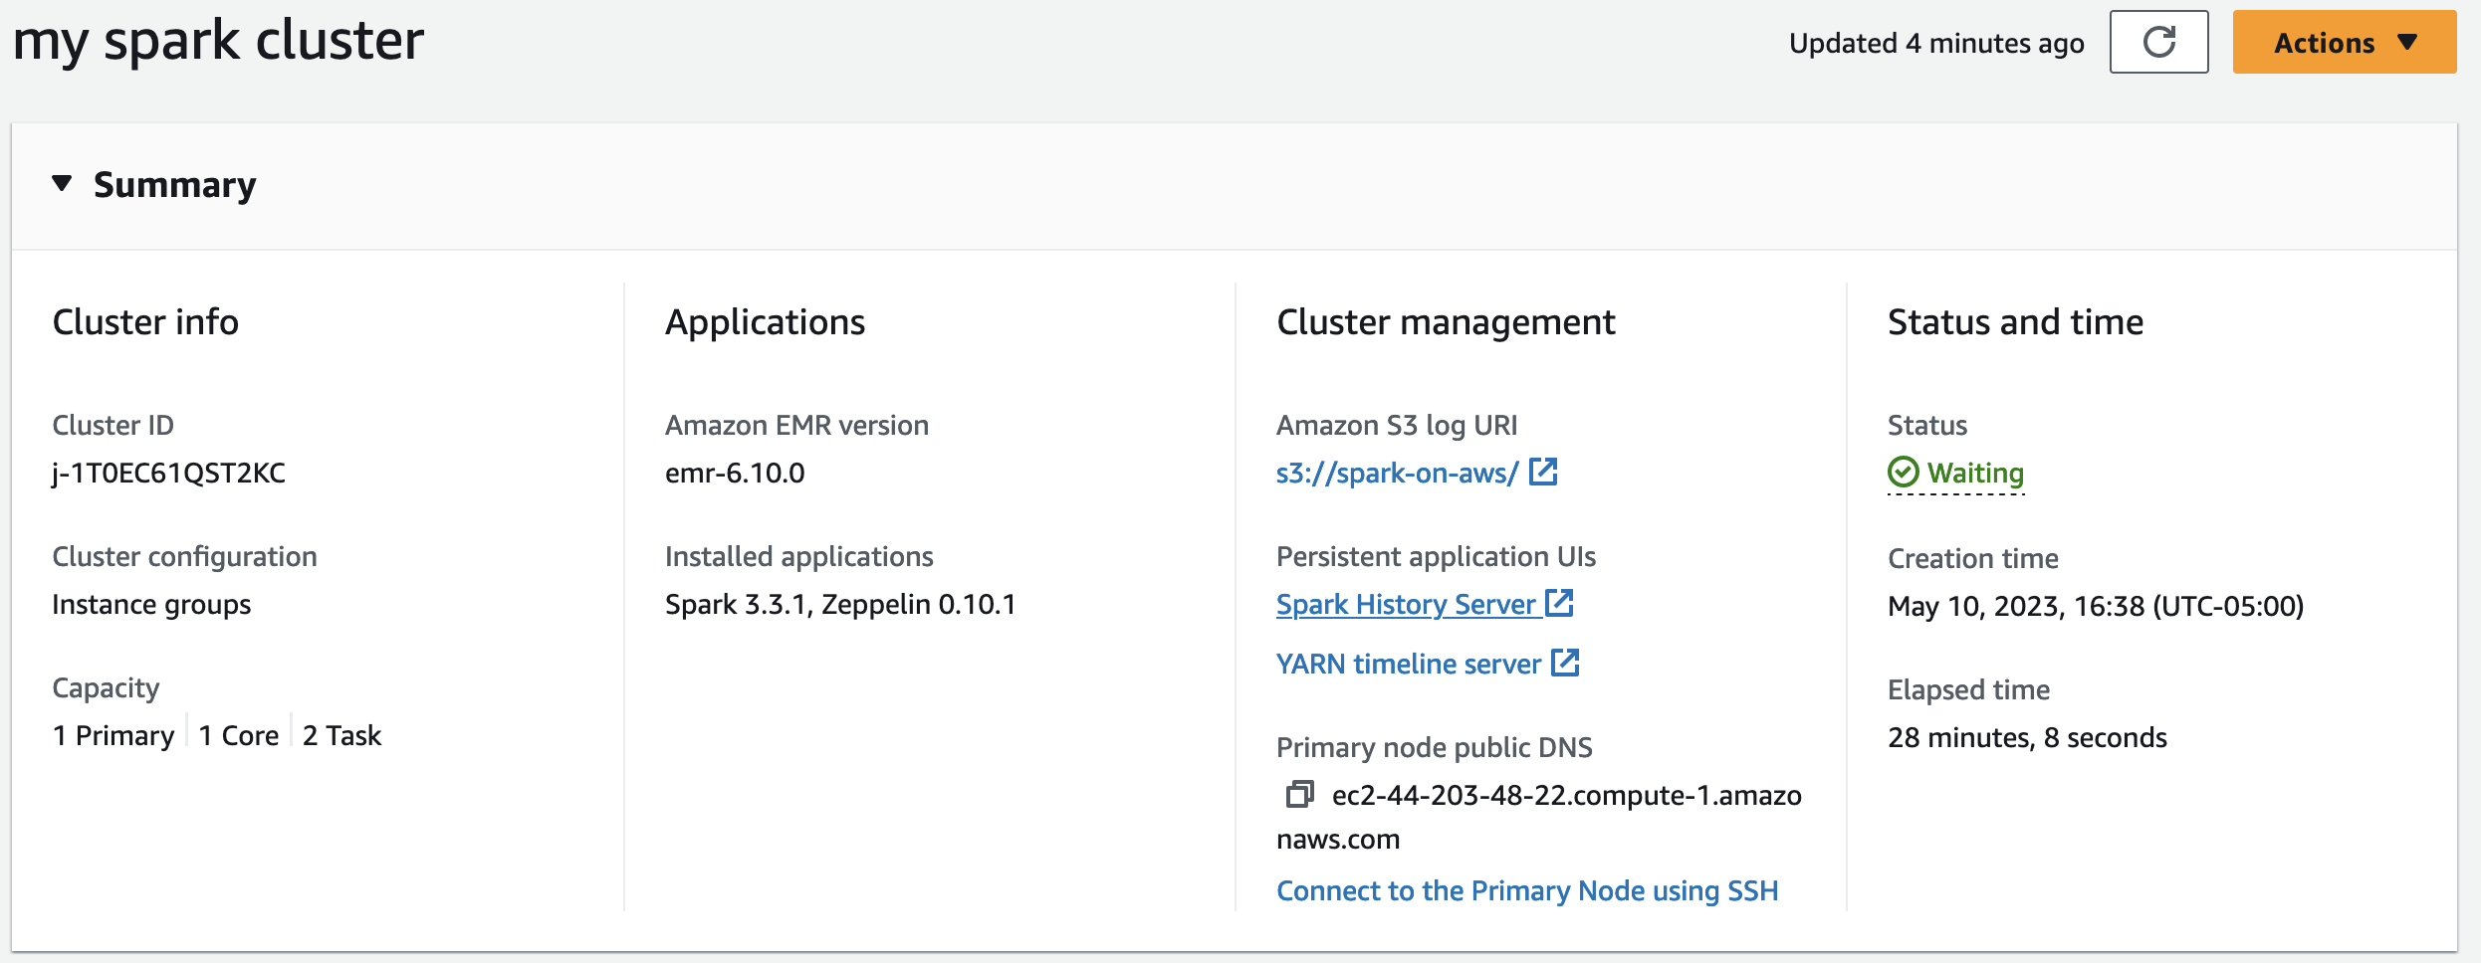
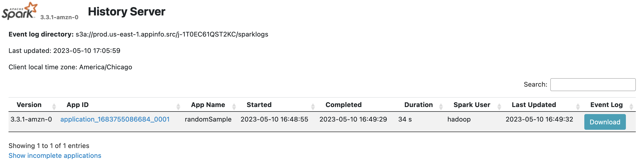
Spark UI
Even simple Spark command can have complex executions under the hood
The Spark engine creates a complex plan for each job (from start to finish)
These plans can automatically cache smaller dataframes and send a copy of them to each node, which can speed up execution times
This is called broadcasting a table!
It reduces the amount of data shuffle between nodes in large table joins
They can even filter out unnecessary columns from the source dataset to speed up the job
This is called predicate pushdown, and is one of the many benefits from using columnar data storage, like parquet

Slide 42
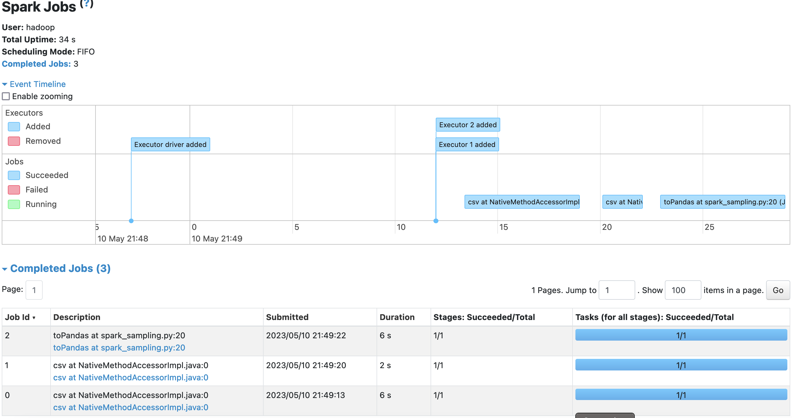
Spark UI

